Slide 1
COM3(0)37 Computer Graphics
Practical Demo 3
Simple Animation

Slide 2
WebGL/OpenGL as a
State Machine
We can think of the graphics system as a finite state machine
Many GL functions change the state of the machine without doing anything else
E.g., gl.ClearColor(1.0, 0.0, 0.0, 1.0)
Makes the active/current clear color red
It doesn’t clear the screen to this color
The clear color remains red until it is changed to a different color

Slide 3
Introduction
Our examples until now were all static
We described a scene, sent data to GPU and rendered
Most real applications require user interaction and dynamically changing output
Now, we will look at
creating animation, and
user interaction (next time)

Slide 4
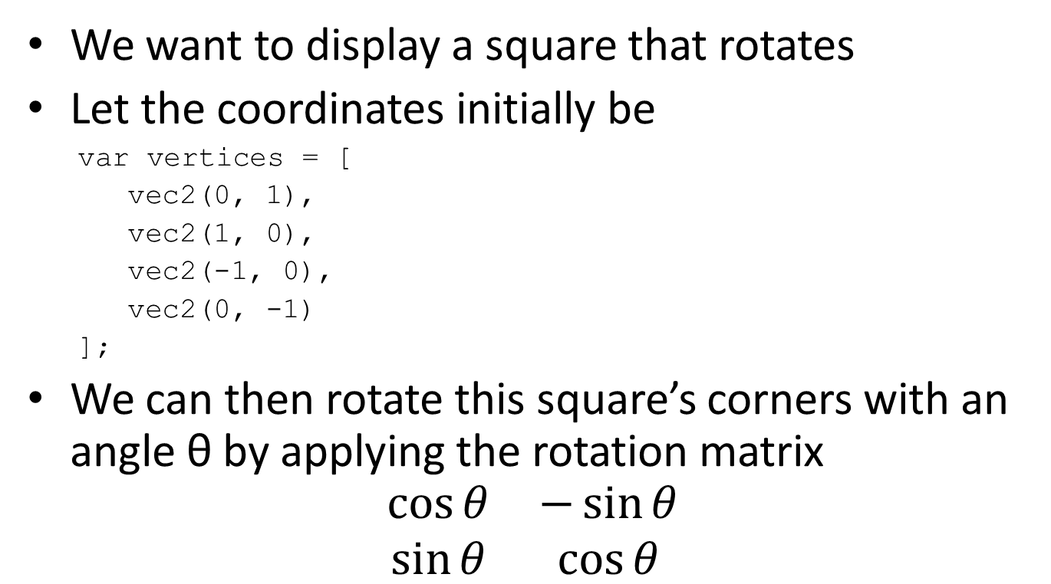
Animating a Rotating Square
We want to display a square that rotates
Let the coordinates initially be
var vertices = [
vec2(0, 1),
vec2(1, 0),
vec2(-1, 0),
vec2(0, -1)
];
We can then rotate this square’s corners with an angle θ by applying the rotation matrix
$$\begin{matrix}\cos{θ} & −\sin{θ} \\ \sin{θ} & \cos{θ}\end{matrix}$$

Slide 5
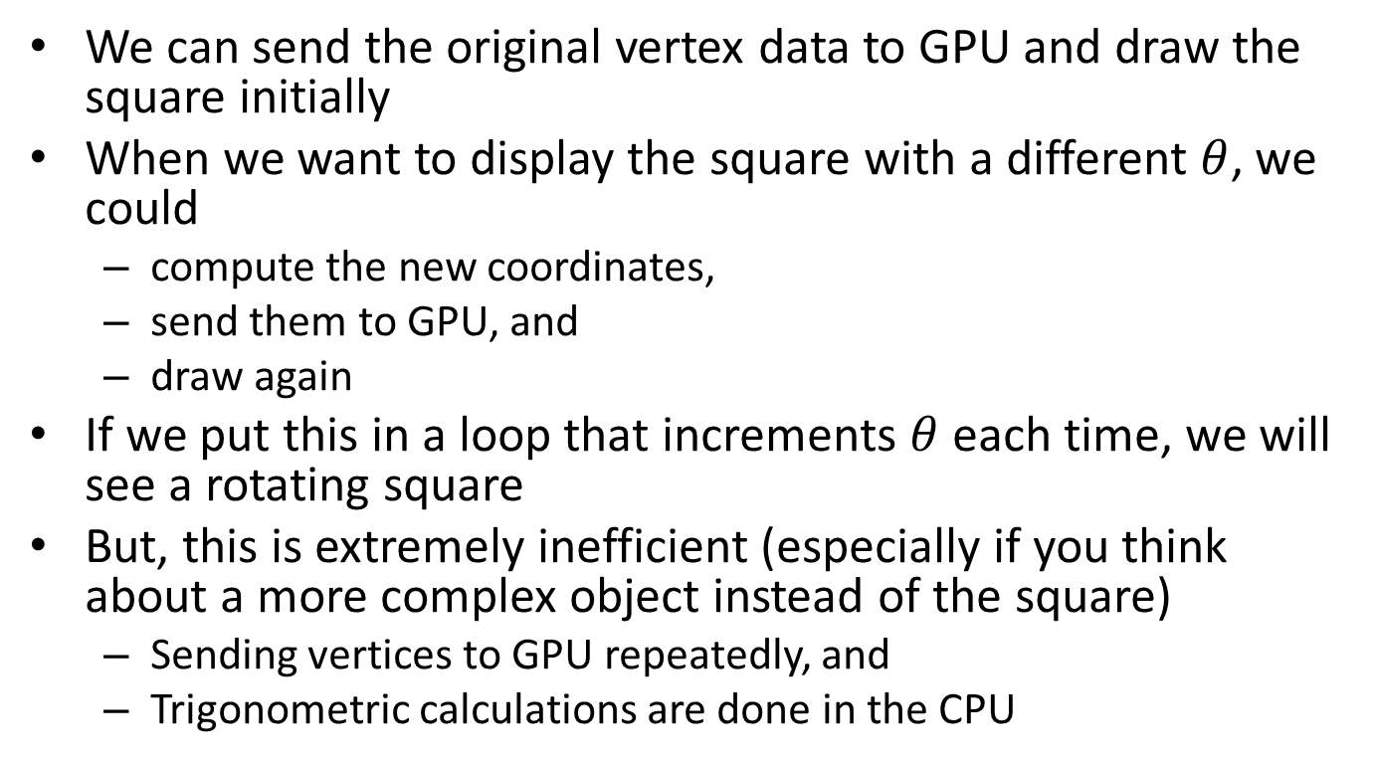
The Rotating Square
We can send the original vertex data to GPU and draw the square initially
When we want to display the square with a different $θ$, we could
compute the new coordinates,
send them to GPU, and
draw again
If we put this in a loop that increments $θ$ each time, we will see a rotating square
But, this is extremely inefficient (especially if you think about a more complex object instead of the square)
Sending vertices to GPU repeatedly, and
Trigonometric calculations are done in the CPU

Slide 6
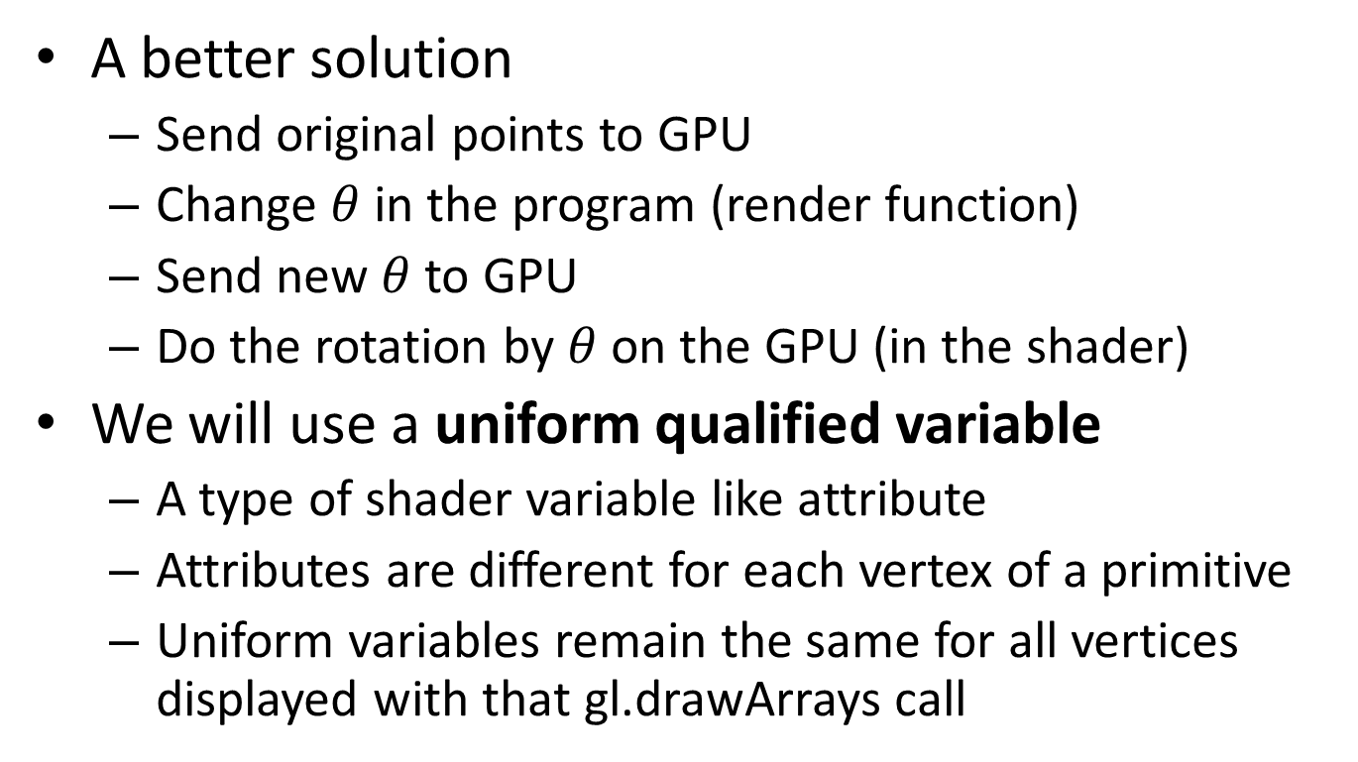
The Rotating Square
A better solution
Send original points to GPU
Change $θ$ in the program (render function)
Send new $θ$ to GPU
Do the rotation by $θ$ on the GPU (in the shader)
We will use a uniform qualified variable
A type of shader variable like attribute
Attributes are different for each vertex of a primitive
Uniform variables remain the same for all vertices displayed with that gl.drawArrays call

Slide 7
Vertex Shader
attribute vec4 vPosition;
uniform float theta;
void main() {
gl_Position.x = cos(theta) * vPosition.x - sin(theta) * vPosition.y;
gl_Position.y = sin(theta) * vPosition.x + cos(theta) * vPosition.y;
gl_Position.z = 0.0;
gl_Position.w = 1.0;
}

Slide 8
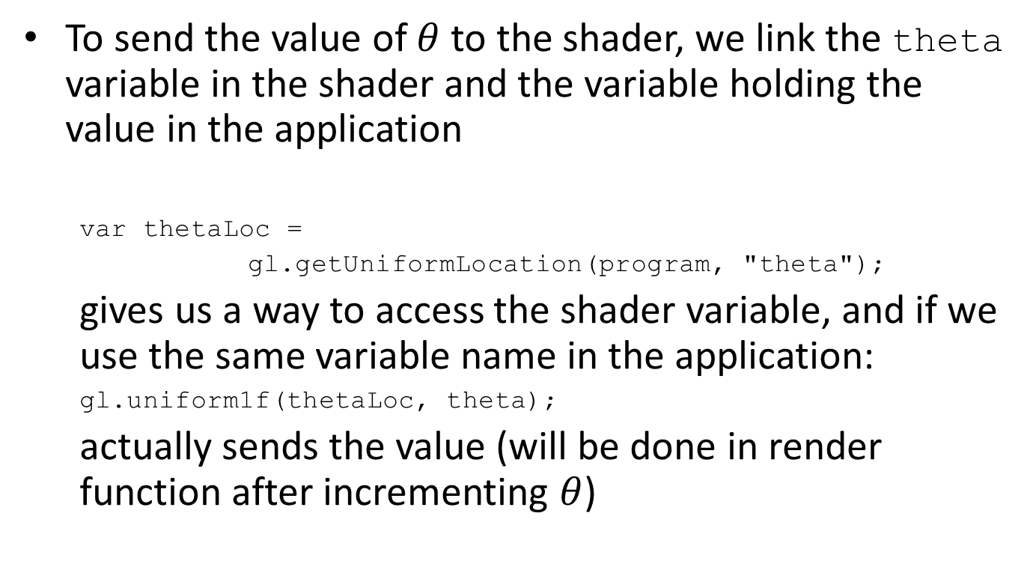
The Rotating Square
To send the value of $θ$ to the shader, we link the theta variable in the shader and the variable holding the value in the application
var thetaLoc =
gl.getUniformLocation(program, "theta");
gives us a way to access the shader variable, and if we use the same variable name in the application:
gl.uniform1f(thetaLoc, theta);
actually sends the value (will be done in render function after incrementing $θ$)

Slide 9
Versions of Functions
There are multiple versions of GL functions
gl.uniform3f(...)
gl.uniform2iv(…)
function name
dimension
gl.uniform3f(x,y,z)
belongs to WebGL canvas
x,y,z are float variables
gl.uniform3fv(p)
p is an array

Slide 10
New Render Function
function render() {
gl.clear(gl.COLOR_BUFFER_BIT);
theta += 0.1;
gl.uniform1f(thetaLoc, theta);
gl.drawArrays(gl.TRIANGLE_FAN, 0, 4);
render();
}

Slide 11
Primitives
Primitives are the basic geometric shapes we use to display graphics
Points, Lines, Triangles, Polygons, Circles, etc.
Many APIs only provide simple primitives
-In WebGL, we only have points, lines, and triangles
We display more complex shapes by using many simple primitives (often approximating the shape)
There are graphics APIs that support other primitives such as text, circles, curves, surfaces, and solids.

Slide 12
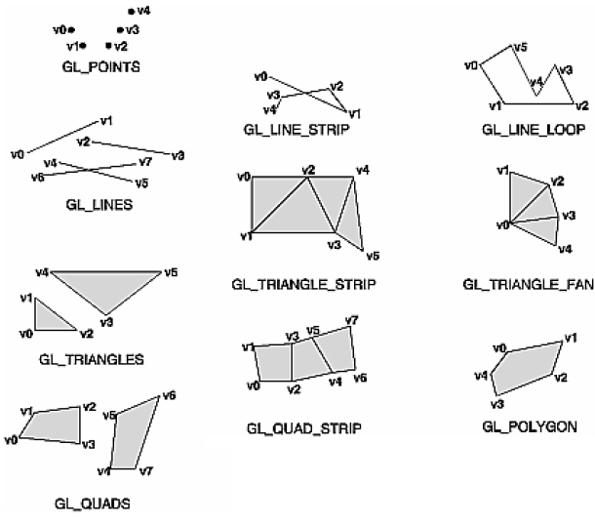
Primitives
X
X
X
X: OLD OPENGL

Slide 13
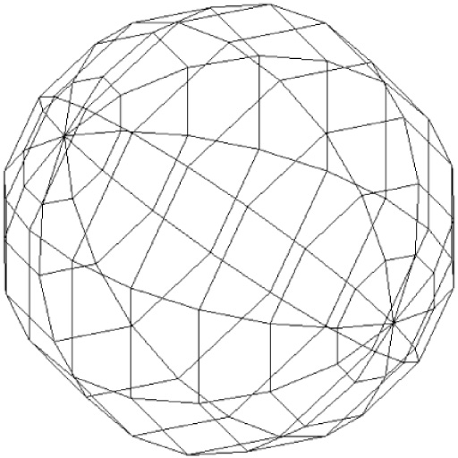
Approximating a Sphere
We can approximate a sphere by
A series of calls with
gl.drawArrays(gl.TRIANGLE_STRIP, …)
And 2 calls with
gl.drawArrays(gl.TRIANGLE_FAN, ...)

Slide 14
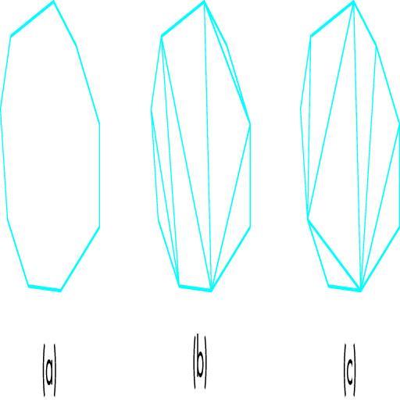
Triangulation

Slide 15
The Rotating Square
The render function recursively calls itself infinitely and changes theta but we won’t see that change on screen
Single Buffer vs. Double Buffer
If there is a single color buffer, we will be both displaying it and changing it
This may cause undesired displays
Because of this, we use double buffering
2 color buffers (front and back)
Front buffer is displayed while changes are made to the back buffer
When we finish changes and want to update display, we swap buffers

Slide 16
Buffer Swap
We can swap buffers
Using timers, or
Using requestAnimFrame function
Timers allow us to call the render function repeatedly with a specific interval in milliseconds
setInterval(render, 16)
0 ms as a parameter cause it to be executed as fast as possible

Slide 17
Buffer Swap
requestAnimFrame function
function render() {
gl.clear(gl.COLOR_BUFFER_BIT);
theta += 0.1;
gl.uniform1f(thetaLoc, theta);
gl.drawArrays(gl.TRIANGLE_STRIP, 0, 4);
requestAnimFrame(render);
}

Slide 18
Buffer Swap
function render() {
setTimeout(function() {
requestAnimFrame(render);
gl.clear(gl.COLOR_BUFFER_BIT);
theta += 0.1;
gl.uniform1f(thetaLoc, theta);
gl.drawArrays(gl.TRIANGLE_STRIP, 0, 4);
}, 100);
}

